Slide 1
Chapter 4:
The Impact of Neoliberalism in the United States:
Ten Consequences
“Markets and money must again become the servants and not the masters of our vision and values.”
… Jackob von Uexkull

Slide 2
Ten Consequences:
1. Reduction of Self-Reliance & Local Economy
2. Unbridled Economic Growth
3. Rampant Consumerism
4. Increased Commodification
Concentration of Corporate Power
Rise of External Costs
Build-Up of Debt
Emasculation of Labor
Widening Social Inequality
Ascension of Dollar Democracy

Slide 3
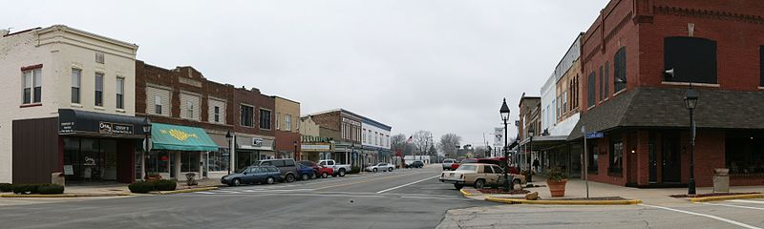
Impact #1: A Reduction of
Self-Reliance and the Local Economy
Notes:
Downtown Rantoul, Illinois; slide accompanies story of self-reliance and a local community. Wikipedia

Slide 4
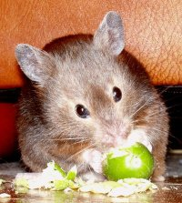
Impact #2:
Unbridled Economic Growth
Notes:
Wikipedia

Slide 5
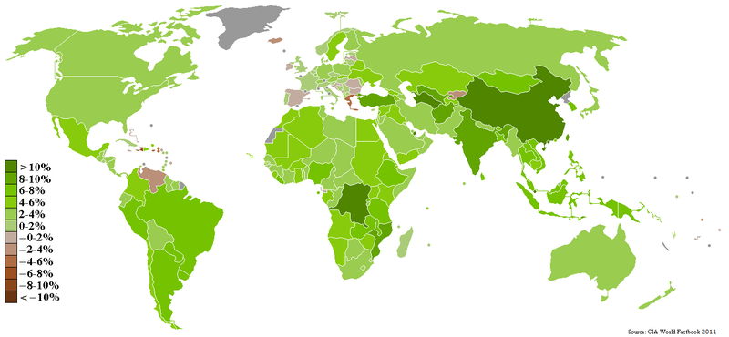
Notes:
CIA Factbook

Slide 6
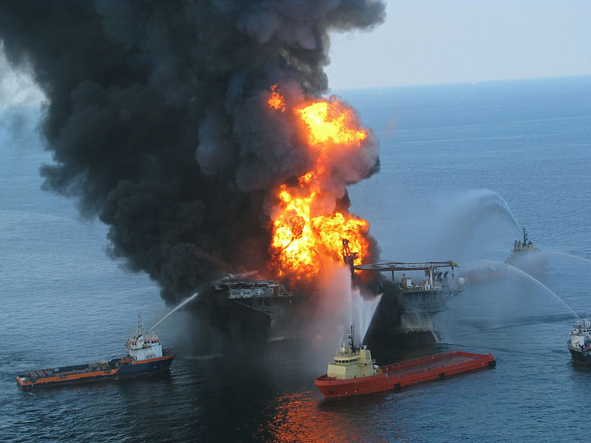
Deepwater Horizon Oil Spill
Notes:
Vessels combat the fire on the Deepwater Horizon while the U.S. Coast Guard searches for missing crew. The clean-up of the BP Oil Spill added to GDP. Wikipedia

Slide 7
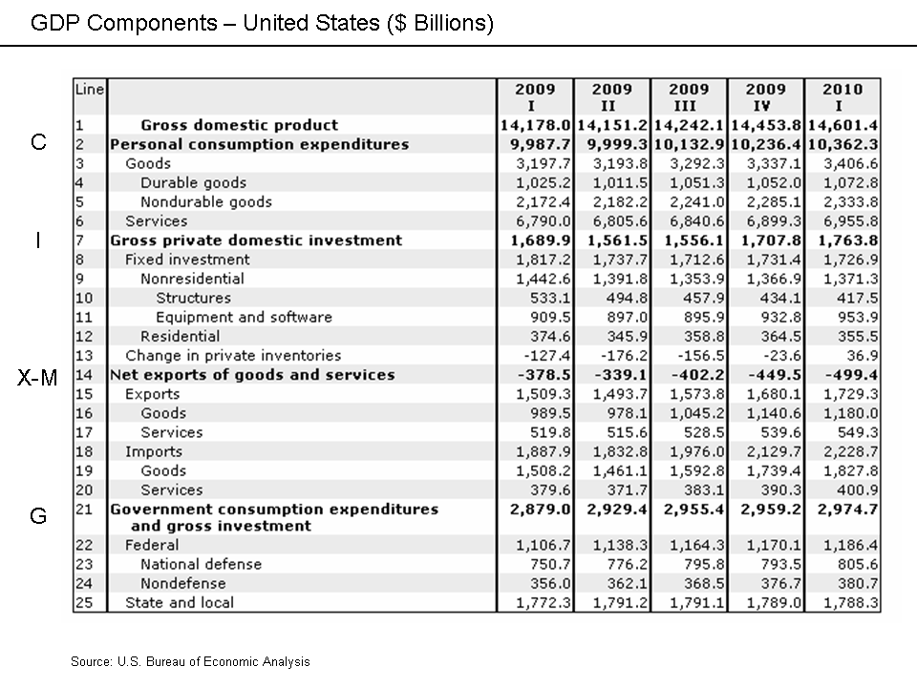
Notes:
United States Department of Commerce - U.S. Bureau of Economic Analysis. Wikipedia

Slide 8
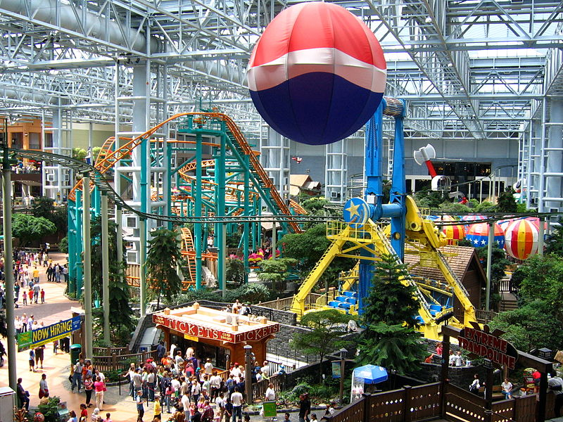
Impact #3: Rampant Consumerism
Notes:
Amusement Park at the center of the Mall of America in Bloomington, Minnesota, the largest shipping mall in the U.S. Wikipedia

Slide 9
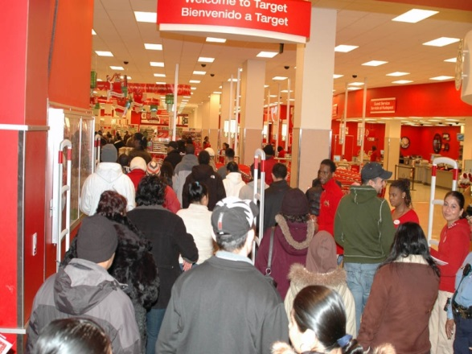
Black Friday Shopping
Notes:
Wikipedia

Slide 10
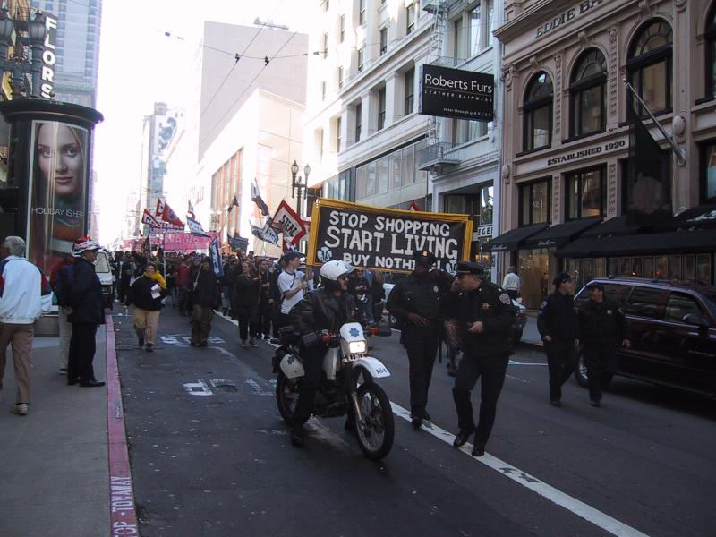
Anti-Consumerism Demonstration
Notes:
Buy Nothing Day demonstration in San Francisco, November 2000This photo (C) Lars Aronsson - Own work Wikipedia

Slide 11
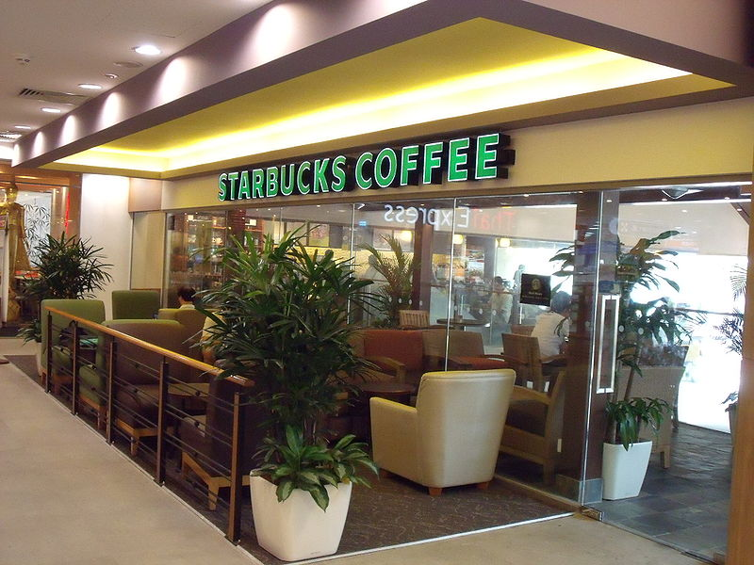
Impact #4: Increased Commodification
Notes:
Starbucks Coffee in Singapore. Wikipedia

Slide 12
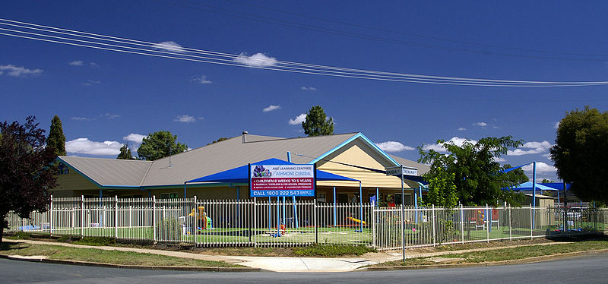
Commodification: Child Care
Notes:
ABC Learning Center – the commodification of child care. Wikipedia

Slide 13
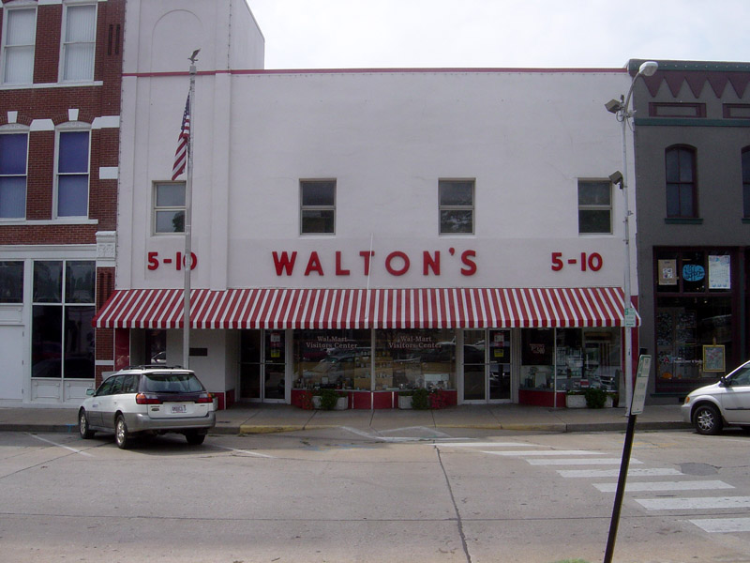
Impact #5:
Concentration of Corporate Power
Notes:
Sam Walton’s original Walton Five and Dime Store in Bentonville, Arkansas, now serving as the Walmart Visitor Center. Wikipedia

Slide 14
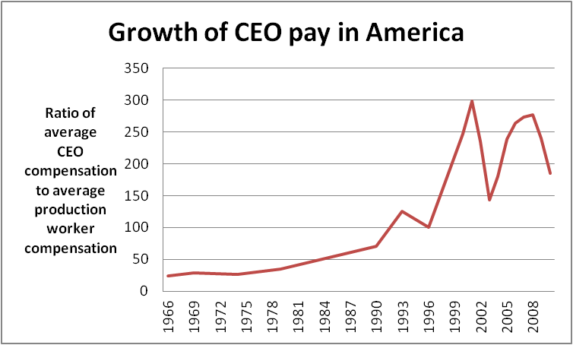
Notes:
Wikipedia

Slide 15
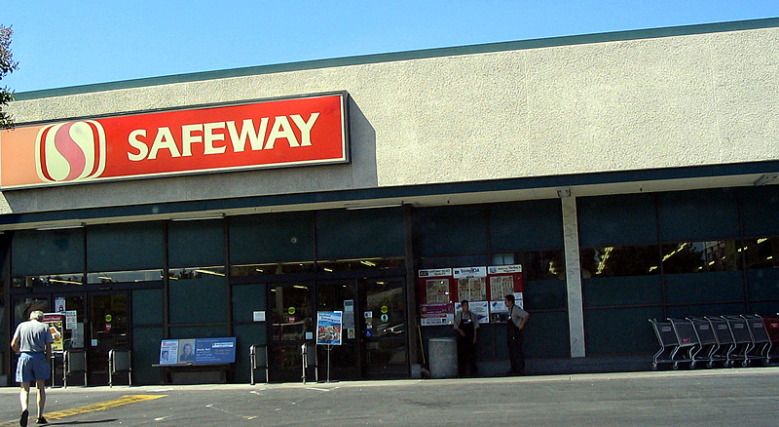
Safeway
Notes:
Wikipedia

Slide 16
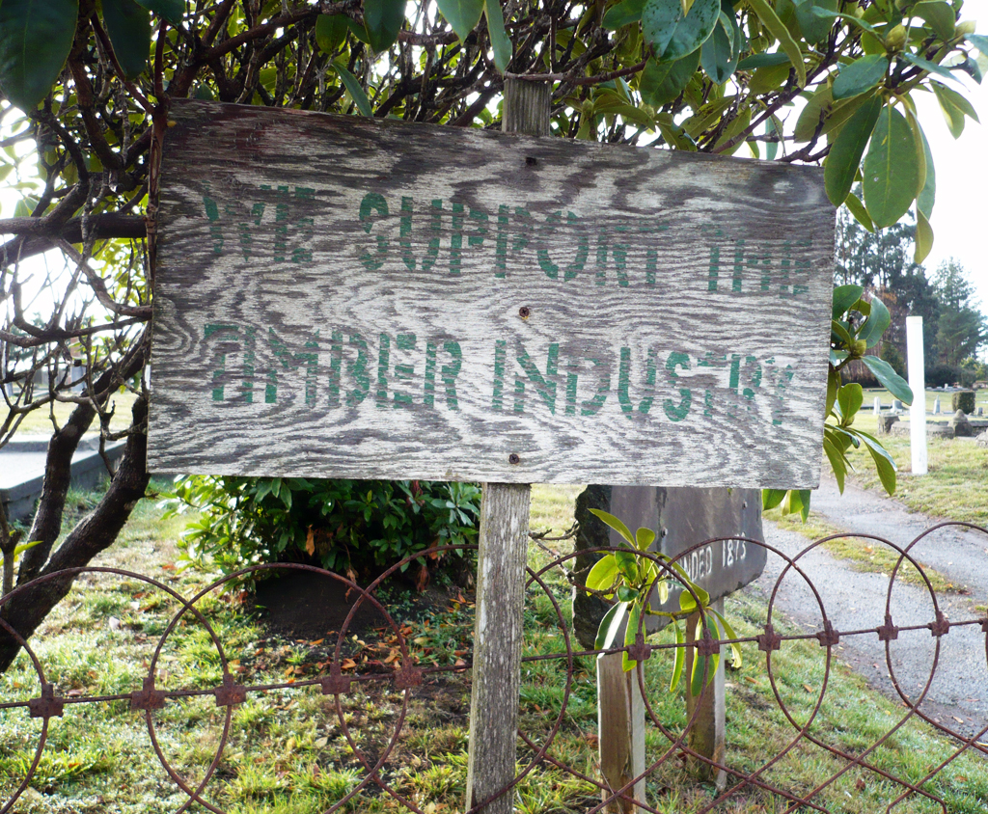
Pacific Lumber Company
Notes:
The "We Support The Timber Industry" signs were painted in 2000-2001 to show support for the now defunct "PALCO" Pacific Lumber Company. Wikipedia

Slide 17
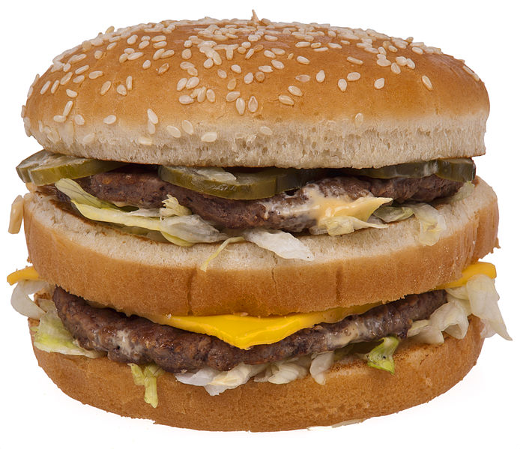
Impact #6: Rise of External Costs
Notes:
McDonald’s Big Mac, introduced in 1968

Slide 18
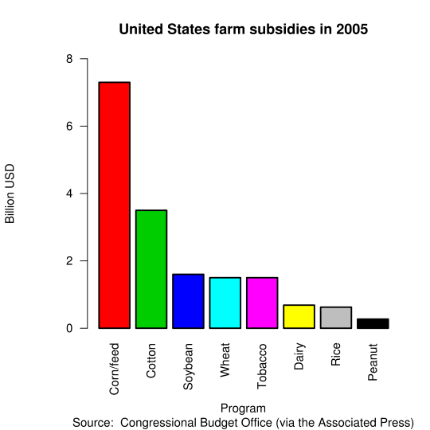
Subsidy

Slide 19
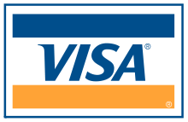
#7: Build-Up of Debt
Notes:
One of the former Visa Logos, used from 1970 to 2006. Visa is the largest credit card company. Wikipedia

Slide 20
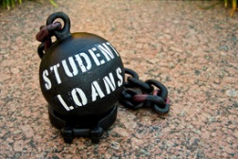
Student Loans: A Ball and Chain
Notes:
Student loans a ball and chain. (no not duplicate)

Slide 21
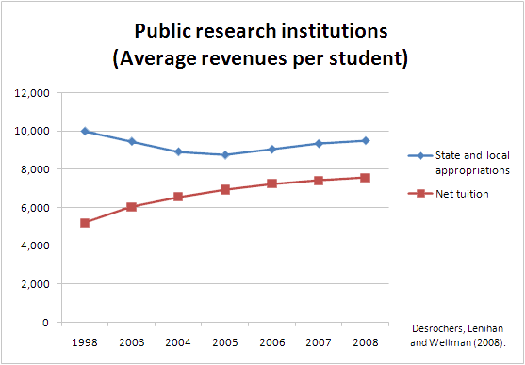
Notes:
Cartoon Diablo at en.wikipedia - Based on the Delta Cost Project study Trends in College Spending 1998-2008, Figure A1, by Donna M. Desrochers, Colleen M. Lenihan and Jane V. Wellman Transferred from en.wikipedia by SreeBot. Wikipedia
Study of rising college costs due to cost shifting from state funding to tuition.

Slide 22
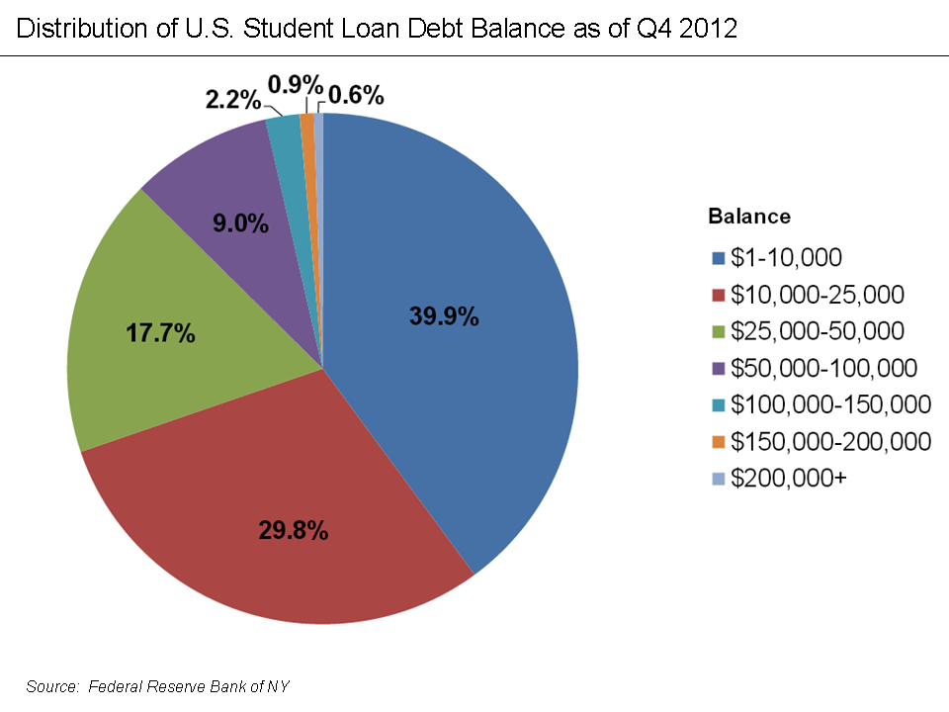
Notes:
Federal Reserve Bank of NY - http://www.newyorkfed.org/studentloandebt/…
U.S. Student Loan Debt Distribution Q4 2012. Wikipedia

Slide 23
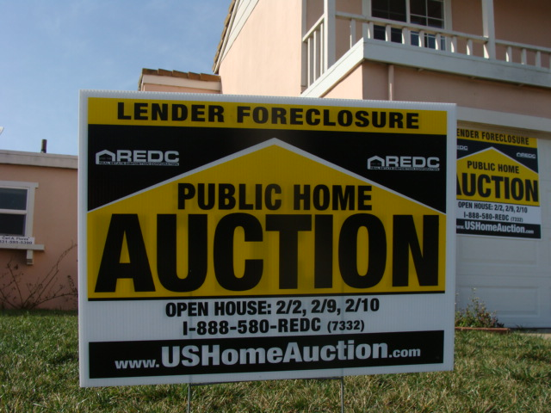
Mortgage Debt
Notes:
House in Salinas, California under foreclosure, following the popping of the U.S. Real Estate bubble. Wikipedia

Slide 24
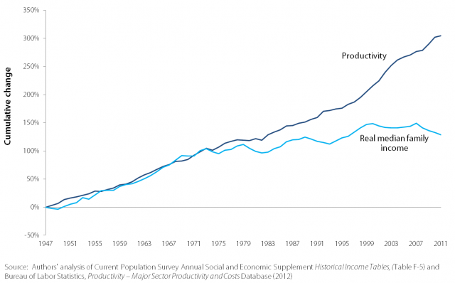
Emasculation of Labor
Notes:
Productivity and Real Median Family Income Growth 1947–2009. Wikipedia

